Slide 1
영상처리 실제 과제(4주차)
학번:2024254002
성명:전창수

Slide 2
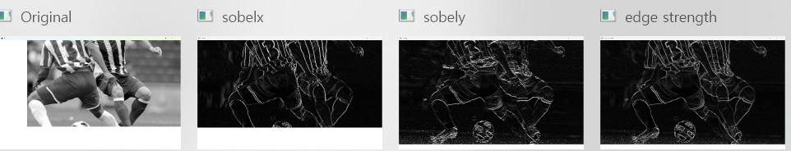
import cv2 as cv
img = cv.imread("C:\soccer.jpg")
gray = cv.cvtColor(img, cv.COLOR_BGR2GRAY)
grad_x = cv.Sobel(gray, cv.CV_32F, 1, 0, ksize=3)
grad_y = cv.Sobel(gray, cv.CV_32F, 0, 1, ksize=3)
sobel_x = cv.convertScaleAbs(grad_x)
sobel_y = cv.convertScaleAbs(grad_y)
edge_strength = cv.addWeighted(sobel_x, 0.5, sobel_y, 0.5, 0)
cv.imshow('Original', gray)
cv.imshow('sobelx', sobel_x)
cv.imshow('sobely', sobel_y)
cv.imshow('edge strength', edge_strength)
cv.waitKey()
cv.destroyAllWindows()

Slide 3
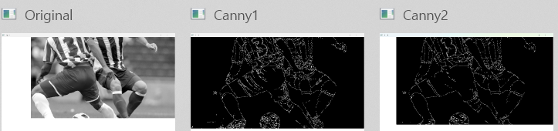
import cv2 as cv
img = cv.imread("C:\soccer.jpg") # 영상 읽기
gray = cv.cvtColor(img, cv.COLOR_BGR2GRAY) # 그레이스케일로 변환
canny1 = cv.Canny(gray, 50, 150) # T_low=50, T_high=150
canny2 = cv.Canny(gray, 100, 200) # T_low=100, T_high=200
cv.imshow('Original', gray)
cv.imshow('Canny1', canny1)
cv.imshow('Canny2', canny2)
cv.waitKey()
cv.destroyAllWindows()

Slide 4
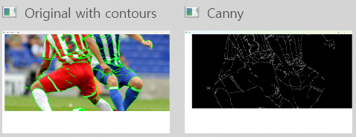
import cv2 as cv
import numpy as np
img = cv.imread("C:\soccer.jpg") # 영상 읽기
gray = cv.cvtColor(img, cv.COLOR_BGR2GRAY) # 흑백 변환
canny = cv.Canny(gray, 100, 200) # 에지 검출
contour, hierarchy = cv.findContours(canny, cv.RETR_LIST, cv.CHAIN_APPROX_NONE)
lcontour = []
for i in range(len(contour)):
if contour[i].shape[0] > 100: # 윤곽선 길이가 100보다 크면
lcontour.append(contour[i])
cv.drawContours(img, lcontour, -1, (0,255,0), 3)
cv.imshow('Original with contours', img)
cv.imshow('Canny', canny)
cv.waitKey()
cv.destroyAllWindows()

Slide 5
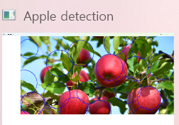
import cv2 as cv
img = cv.imread("C:/apples.jpg") # 또는 C:\\apples.jpg 또는 r"C:\apples.jpg"
if img is None:
print("이미지를 불러올 수 없습니다. 경로를 확인하세요.")
exit()
gray = cv.cvtColor(img, cv.COLOR_BGR2GRAY)
apples = cv.HoughCircles(
gray,
cv.HOUGH_GRADIENT,
1,
200,
param1=150,
param2=20,
minRadius=50,
maxRadius=120
)
if apples is not None:
for i in apples[0]:
cv.circle(img, (int(i[0]), int(i[1])), int(i[2]), (255, 0, 0), 2)
cv.imshow('Apple detection', img)
cv.waitKey()
cv.destroyAllWindows()

Slide 6
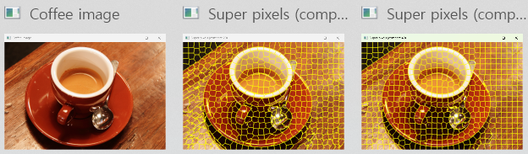
import skimage
import numpy as np
import cv2 as cv
img = skimage.data.coffee()
cv.imshow('Coffee image', cv.cvtColor(img, cv.COLOR_RGB2BGR))
slic1 = skimage.segmentation.slic(img, compactness=20, n_segments=600)
sp_img1 = skimage.segmentation.mark_boundaries(img, slic1)
sp_img1 = np.uint8(sp_img1 * 255.0)
slic2 = skimage.segmentation.slic(img, compactness=40, n_segments=600)
sp_img2 = skimage.segmentation.mark_boundaries(img, slic2)
sp_img2 = np.uint8(sp_img2 * 255.0)
cv.imshow('Super pixels (compact 20)', cv.cvtColor(sp_img1, cv.COLOR_RGB2BGR))
cv.imshow('Super pixels (compact 40)', cv.cvtColor(sp_img2, cv.COLOR_RGB2BGR))
cv.waitKey()
cv.destroyAllWindows()

Slide 7
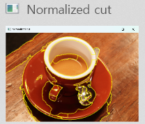
import skimage
from skimage import graph
import numpy as np
import cv2 as cv
import time
coffee = skimage.data.coffee()
start = time.time()
slic = skimage.segmentation.slic(coffee, compactness=20, n_segments=600, start_label=1)
g = graph.rag_mean_color(coffee, slic, mode='similarity')
ncut = graph.cut_normalized(slic, g)
print(coffee.shape, ' Coffee 영상을 분할하는 데 ', time.time() - start, '초 소요')
marking = skimage.segmentation.mark_boundaries(coffee, ncut)
ncut_coffee = np.uint8(marking * 255.0)
cv.imshow('Normalized cut', cv.cvtColor(ncut_coffee, cv.COLOR_RGB2BGR))
cv.waitKey()
cv.destroyAllWindows()

Slide 8
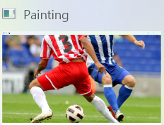
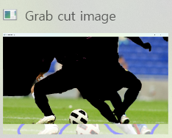
import cv2 as cv
import numpy as np
img = cv.imread(r"C:\soccer.jpg") # ← 경로 수정
if img is None:
print("이미지를 불러올 수 없습니다.")
exit()
img_show = img.copy()
mask = np.zeros((img.shape[0], img.shape[1]), np.uint8)
mask[:,:] = cv.GC_PR_BGD
BrushSiz = 9
LColor, RColor = (255, 0, 0), (0, 0, 255)
def painting(event, x, y, flags, param):
if event == cv.EVENT_LBUTTONDOWN or (event == cv.EVENT_MOUSEMOVE and flags == cv.EVENT_FLAG_LBUTTON):
cv.circle(img_show, (x, y), BrushSiz, LColor, -1)
cv.circle(mask, (x, y), BrushSiz, cv.GC_FGD, -1)
elif event == cv.EVENT_RBUTTONDOWN or (event == cv.EVENT_MOUSEMOVE and flags == cv.EVENT_FLAG_RBUTTON):
cv.circle(img_show, (x, y), BrushSiz, RColor, -1)
cv.circle(mask, (x, y), BrushSiz, cv.GC_BGD, -1)
cv.namedWindow('Painting')
cv.setMouseCallback('Painting', painting)
# 그리기 루프
while True:
cv.imshow('Painting', img_show)
if cv.waitKey(1) == ord('q'):
break
# GrabCut 적용
background = np.zeros((1, 65), np.float64)
foreground = np.zeros((1, 65), np.float64)
cv.grabCut(img, mask, None, background, foreground, 5, cv.GC_INIT_WITH_MASK)
mask2 = np.where((mask == cv.GC_BGD) | (mask == cv.GC_PR_BGD), 0, 1).astype('uint8')
grab = img * mask2[:, :, np.newaxis]
cv.imshow('Grab cut image', grab)
cv.waitKey()
cv.destroyAllWindows()

Slide 9
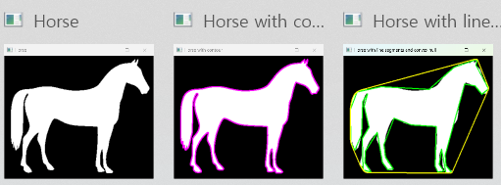
import skimage
import numpy as np
import cv2 as cv
orig = skimage.data.horse()
img = 255 - np.uint8(orig) * 255 # 반전하여 흰 말 → 검은 배경
cv.imshow('Horse', img)
contours, hierarchy = cv.findContours(img, cv.RETR_EXTERNAL, cv.CHAIN_APPROX_NONE)
img2 = cv.cvtColor(img, cv.COLOR_GRAY2BGR)
cv.drawContours(img2, contours, -1, (255, 0, 255), 2)
cv.imshow('Horse with contour', img2)
contour = contours[0]
m = cv.moments(contour)
area = cv.contourArea(contour)
cx = m['m10']/m['m00']
cy = m['m01']/m['m00']
perimeter = cv.arcLength(contour, True)
roundness = (4 * np.pi * area) / (perimeter ** 2)
print('면적=', area, '\n중점=(', cx, ',', cy, ')', '\n둘레=', perimeter, '\n둥근 정도=', roundness)
img3 = cv.cvtColor(img, cv.COLOR_GRAY2BGR)
contour_approx = cv.approxPolyDP(contour, 8, True) # 윤곽선 단순화
cv.drawContours(img3, [contour_approx], -1, (0, 255, 0), 2)
hull = cv.convexHull(contour)
hull = hull.reshape(1, hull.shape[0], hull.shape[2])
cv.drawContours(img3, hull, -1, (0, 255, 255), 2)
cv.imshow('Horse with line segments and convex hull', img3)
cv.waitKey()
cv.destroyAllWindows()

